Slide 1
Lesson #4
Sentence formation, past, future, past participles

Slide 2
Review
Things you get on: train, plane, bus, boat. When talking about commercial or public transportation, such as a train or plane, use the preposition on.
Things you get in: taxi, car, truck. When it comes to personal modes of transportation, such as a taxi or a car, use the preposition in.
ON AND IN!!

Slide 3
Review - LAST CLASS!
I would / I will
May I get? / May I have?
Can I have / Can I get?
Change it VS. exchange it
To get VS. To have
The shopping? Articles! (verbs)

Slide 4
Homework
Make sentences with these verbs / Forme frases com esses verbos
To be
To do
To have
To say
To go
In the PAST and FUTURE!

Slide 5
QUESTIONS??
From the homework
In general

Slide 6
Past and Future

Slide 7
FIRST - REMEMBER!
My
Your
His, Her, Its
Our
Your
Their
I
You
He, She, It
We
You
They
VS

Slide 8
IT = PRONOUN
ITS = POSSESSIVE PRONOUN
IT’S = IT + IS

Slide 9
“To be”
Past
Future
I
You
He, She, It
We
You
They
was
were
were
were
were
were
will be
will be
will be
will be
will be
will be

Slide 10
“To do”
Past
Future
I
You
He, She, It
We
You
They
did
did
did
were
were
were
will do
will do
will do
will do
will do
will do

Slide 11
“To have”
Past
Future
I
You
He, She, It
We
You
They
had
had
had
had
had
had
will have
will have
will have
will have
will have
will have

Slide 12
“To say”
Past
Future
I
You
He, She, It
We
You
They
said
said
said
said
said
said
will say
will say
will say
will say
will say
will say

Slide 13
“To go”
Past
Future
I
You
He, She, It
We
You
They
went
went
went
went
went
went
will go
will go
will go
will go
will go
will go

Slide 14
Past Participles

Slide 15
What are they?
There are 12 tenses in English:
Present Simple Tense
Present Continuous Tense
Present Perfect Tense
Present Perfect Continuous Tense
Past Simple Tense
Past Continuous Tense
Past Perfect Tense
Past Perfect Continuous Tense
I do
I am doing
I have done
I have been doing
I did
I was doing
I had done
I had been doing

Slide 16
Continuous VS Perfect
I am doing VS I have done

Slide 17
Past Participles = Present Perfect

Slide 18
Present Perfect
I have + PAST PARTICIPLE
Examples:
I have done
I have written
I have run
I have worked

Slide 19
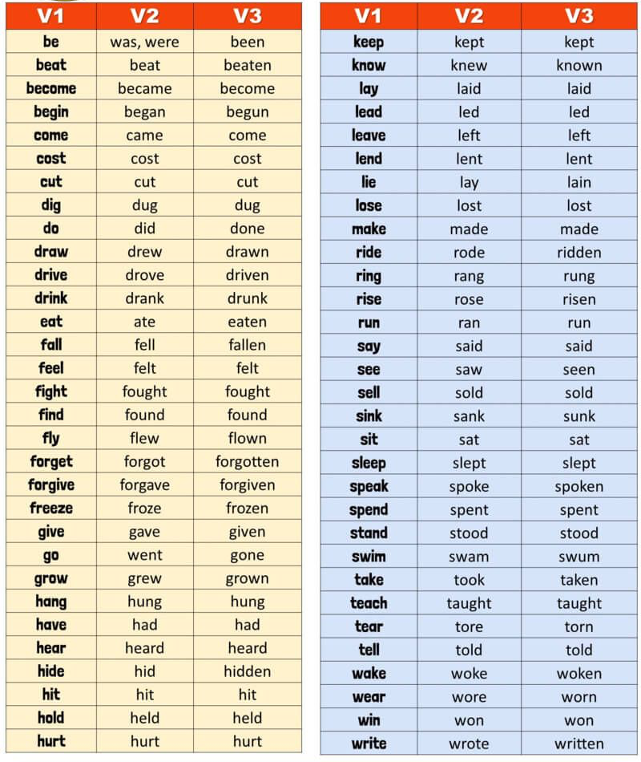

Slide 20
Homework
LEARN THE BASIC PARTICIPLES!

